Slide 1
CAPSTONE PROJECT
Bike Sharing Demand Prediction
TEAM MEMBERS
JAKKALI MAHESH
BAMAN BHAVAN SINGH

Slide 2
CONTENT
BUSINESS UNDERSTANDING
DATA SUMMARY
FEATURE ANALYSIS
EXPLORATORY DATA ANALYSIS
DATA PREPROCESSING
IMPLEMENTING ALGORITHMS
CHALLENGES
CONCLUSIONS

Slide 3
BUSINESS UNDERSTANDING
Bike rentals have became a popular service in recent years and it seems people are using it more often. With relatively cheaper rates and ease of pick up and drop at own convenience is what making this business thrive.
Mostly used by people having no personal vehicles and also to avoid congested public transport which that’s why they prefer rental bikes.
Therefore, the business to strive and proﬁt more, it has to be always ready and supply no. of bikes at different locations, to fulﬁl the demand.
Our project goal is a pre planned set of bike count values that can be a handy solution to meet all demands.

Slide 4
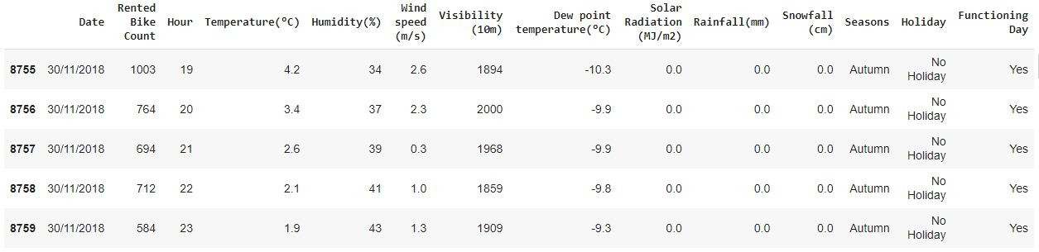
DATA SUMMARY
This Dataset contains 8760 lines and 14 columns.
Three categorical features ‘Seasons’, ‘Holiday’, & ‘Functioning Day’.
One Datetime features ‘Date’.
We have some numerical type variables such as temperature, humidity, wind, visibility, dew point temp, solar radiation, rainfall, snowfall which tells the environment conditions at that particular hour of the day.

Slide 5
FEATURE SUMMARY
Date : Year-Month-Day
Rented Bike Count - Count of bikes rented at each hour
Hour - Hour of the day
Temperature - Temperature in Celsius
Humidity - %
Wind Speed - m/s
Visibility - 10m
Dew point temperature -Celsius
Solar radiation -MJ/m2
Rainfall -mm
Snowfall -cm
Seasons -Winter, Spring, Summer, Autumn
Holiday -Holiday/No Holiday
Functional Day - NoFunc(Non Functional Hrs),Fun(Functional Hrs)

Slide 6
INSIGHTS FROM OUR DATASET
There are No Missing Values present
There are No Duplicate values present
There are No null values.
And ﬁnally we have 'rented bike count' variable which we need to predict for new observations
The dataset shows hourly rental data for one year (1 December 2017 to 31 November(2018)(365 days).we consider this as a single year data
We change the name of some features for our convenience , they are as below 'Rented_Bike_Count', 'Hour', 'Temperature', 'Humidity', 'Wind_speed', 'Visibility', ‘Dew_point_temperature', 'Solar_Radiation', 'Rainfall', 'Snowfall', 'Seasons', 'Holiday', 'Functioning_Day', 'month','weekdays_weekend'

Slide 7
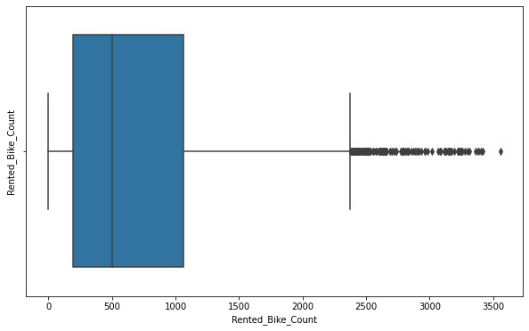
ANALYSIS OF RENTED BIKE COLUMN
The above boxplot shows that we have detect outliers in Rented Bike Count column
Since the assumption of linear regression is that 'the distribution of dependent variable has to be normal', so we should perform Square root operation to make it normal

Slide 8
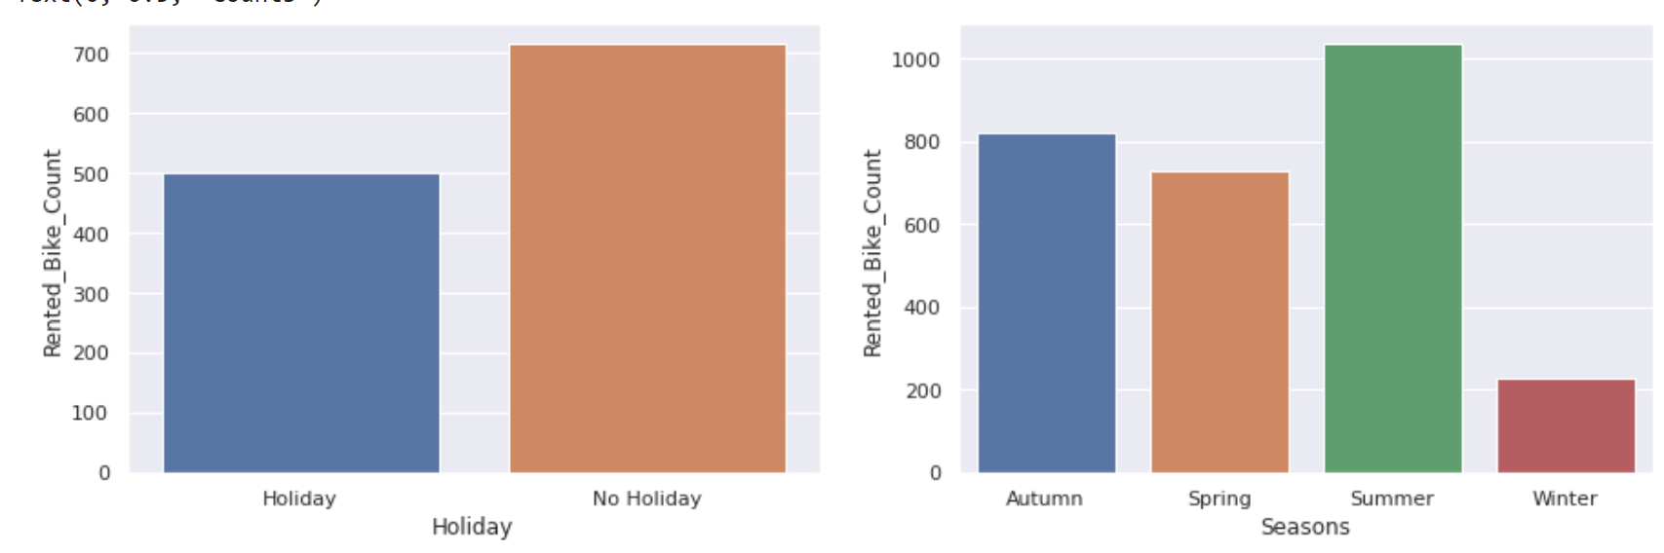

Slide 9
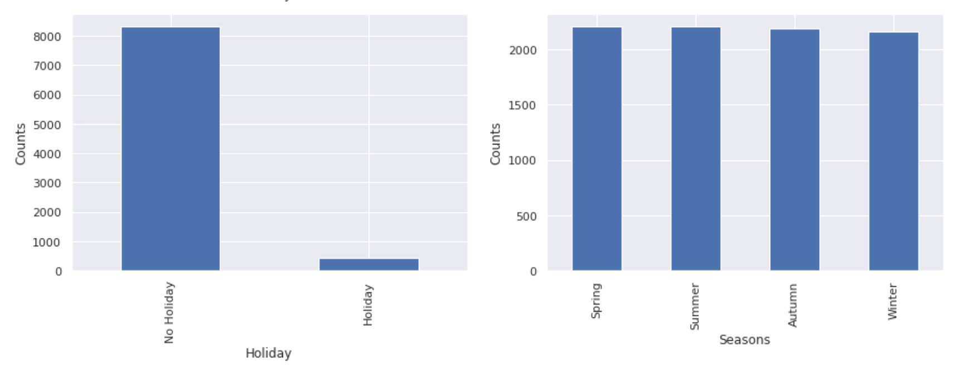
We are given the data of one year which include many weather factors such as seasons , humidity etc.
From the above data, we observe that large number of bikes are being rented when there is a working day/No Holiday and more often in summer season. Even in general also, bikes are being rented more in the working day itself regardless of the seasons.

Slide 10
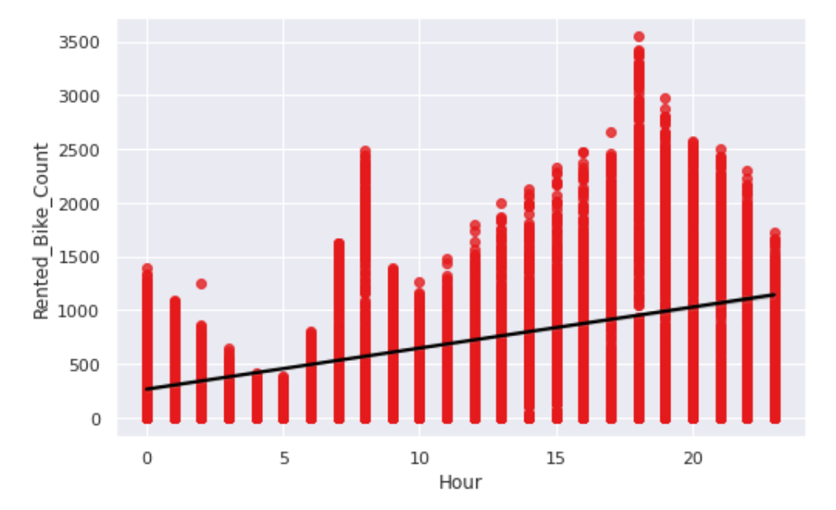
ANALYSIS OF FUNCTIONING DAY VARIABLE
There must be high demand during the office timings around 8 A.M. and 8 P.M., also for early morning and late evening we are having a relatably different trends. And, definately low demand between 8 A.M. and 8 P.M..

Slide 11
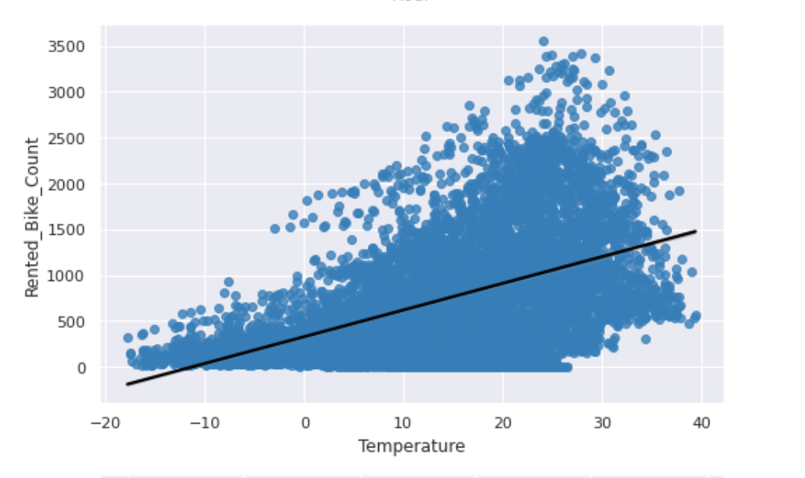
In general, temperature has negative correlation with the bike demands. So, as the temperature increases, the bike count also increases.

Slide 12
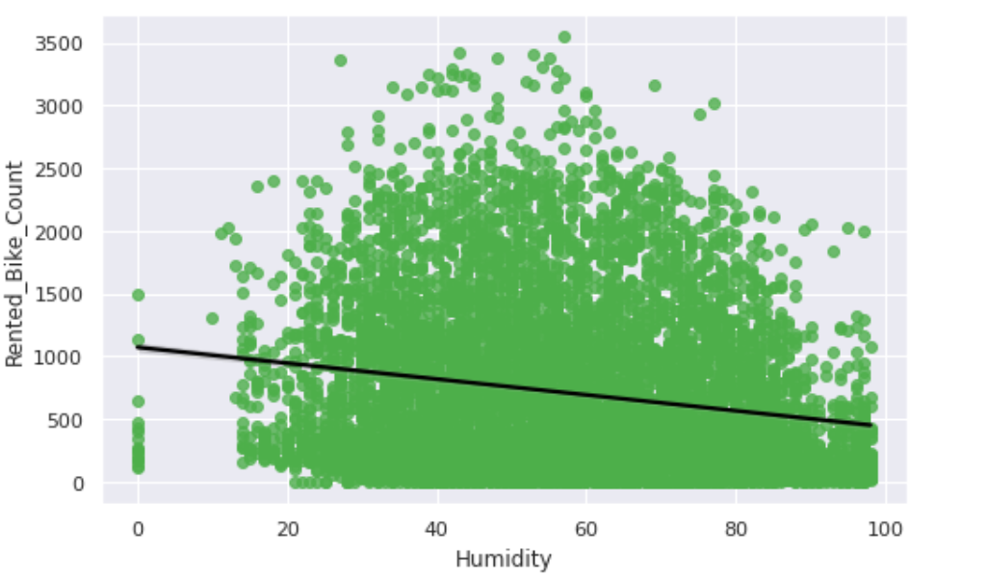
Humidity acts as a deterrent to a bike ride. The bike count decreases when the humidity increases.

Slide 13
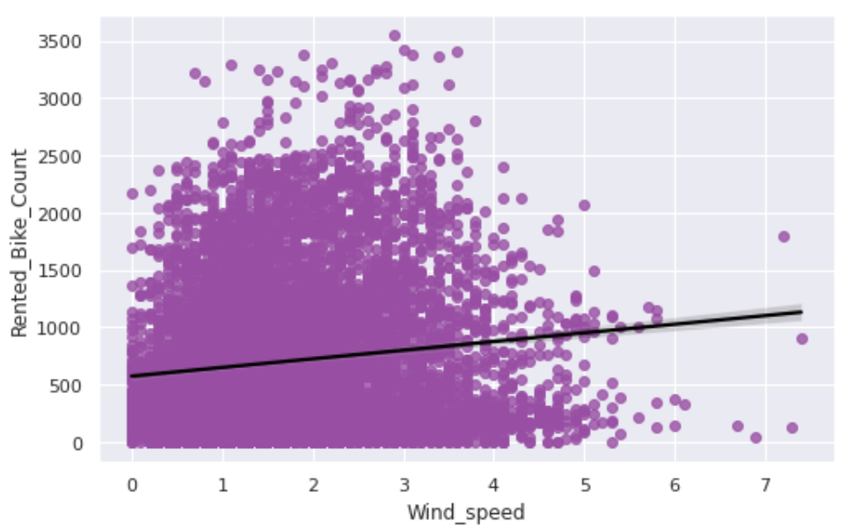
Wind Speed:
Due to Wind speed , there is certain increase in the bike count but the change is very small.

Slide 14
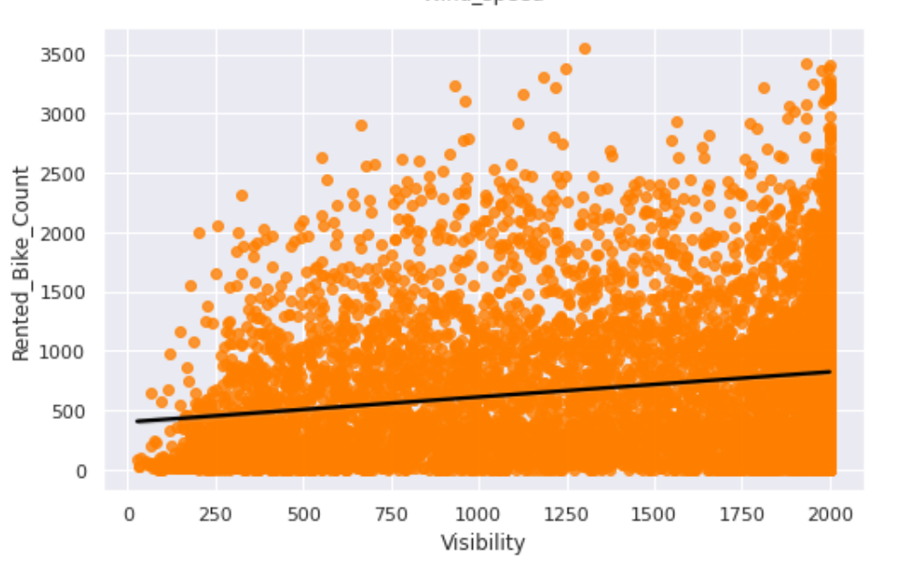
Visibility:
If there is low visibility, people won't prefer to ride the bike. So,as the visibility increases , the number of bike count also increases.

Slide 15
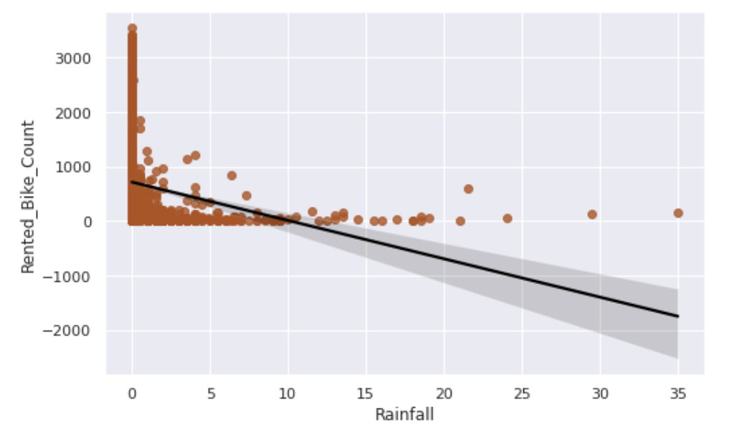
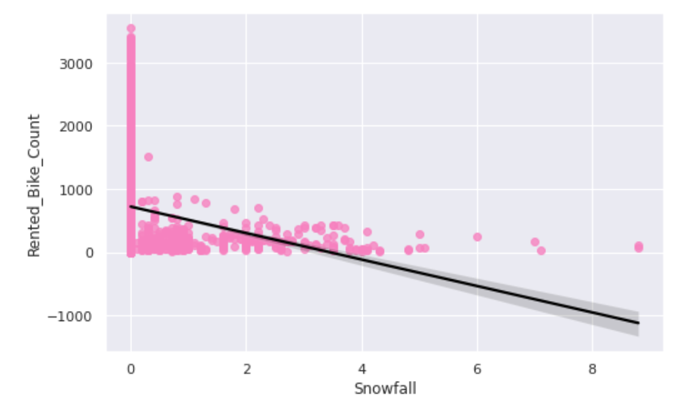
Rainfall and Snowfall:
If there is rainfall/Snowfall, people don't prefer to travel out. And, hence the bike count decreases.

Slide 16
REGRESSION PLOT FOR NUMERICAL VARIABLE
From the above regression plot of all numerical features we see that the columns 'Temperature', 'Wind_speed','Visibility', 'Dew_point_temperature', 'Solar_Radiation' are positively relation to the target variable.
which means the rented bike count increases with increase of these features.
'Rainfall','Snowfall','Humidity' these features are negatively related with the target variable which means the rented bike count decreases when these features increase.

Slide 17
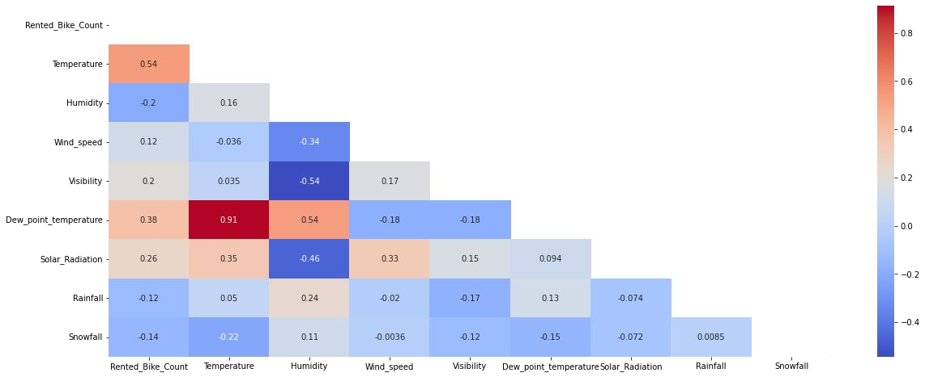
CORRELATION MATRIX
Variables like Dew Point Temperature, and Temperature are highly correlated.

Slide 18
MODEL BUILDING
LINEAR REGRESSION
LASSO REGRESSION
RIDGE REGRESSION
DECISION TREES REGRESSOR
RANDOM FOREST REGRESSOR
GRADIENT BOOSTED REGRESSOR
GRADIENT BOOSTING REGRESSOR WITH GRIDSEARCHCV

Slide 19
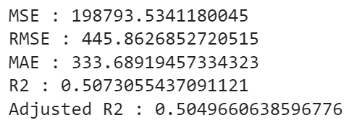
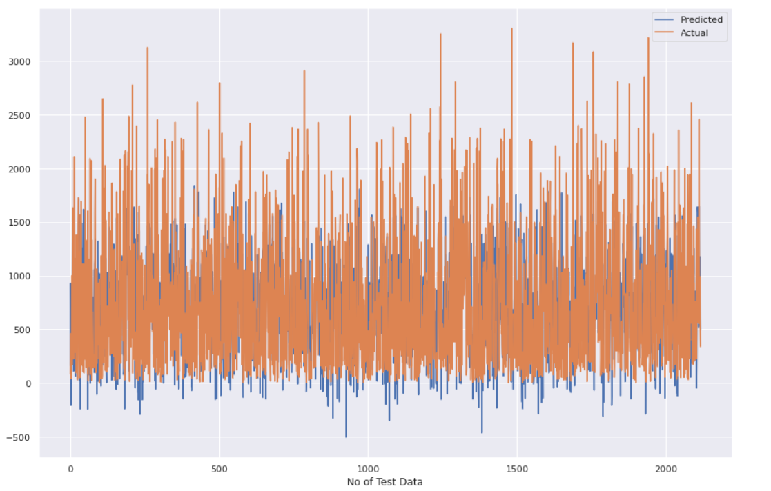
LINEAR REGRESSION
Test Set Results

Slide 20
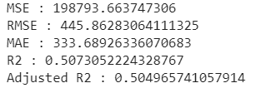
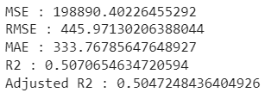
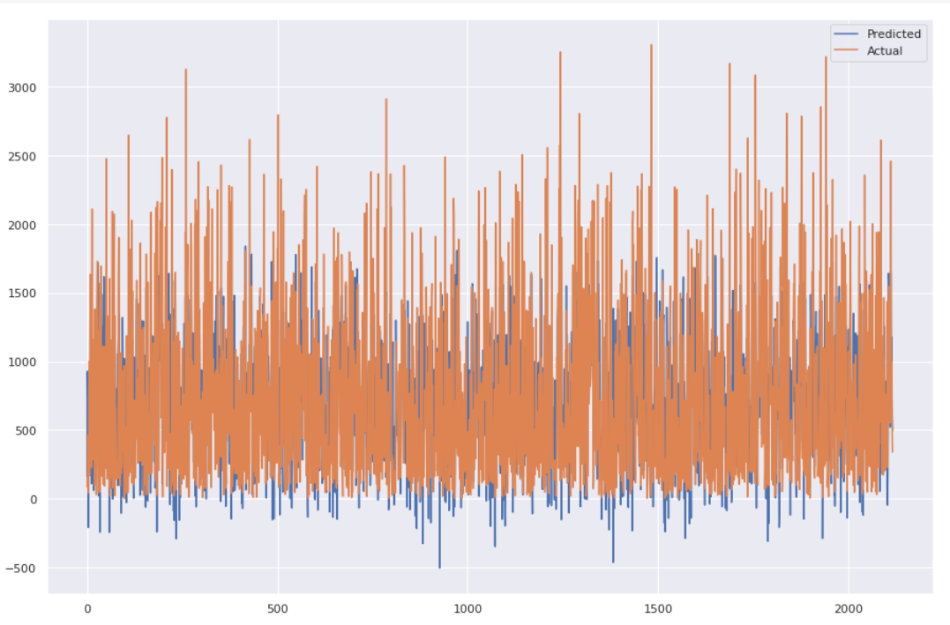
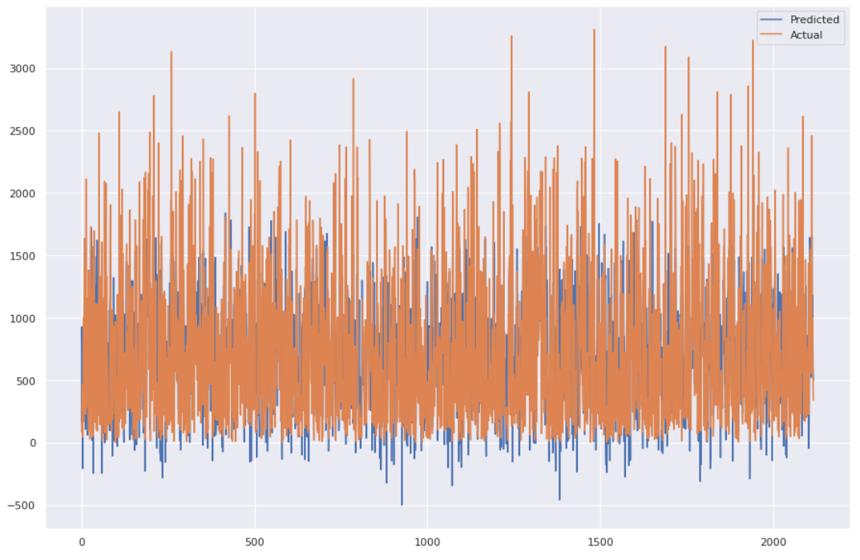
LASSO REGRESSION
RIDGE REGRESSION
Test Set Results
Test Set Results

Slide 21
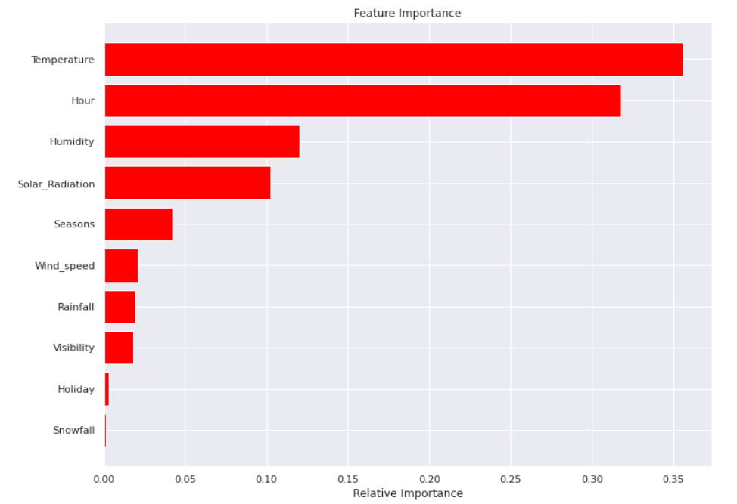
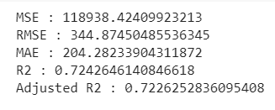
DECISION TREE
Test Set Results

Slide 22
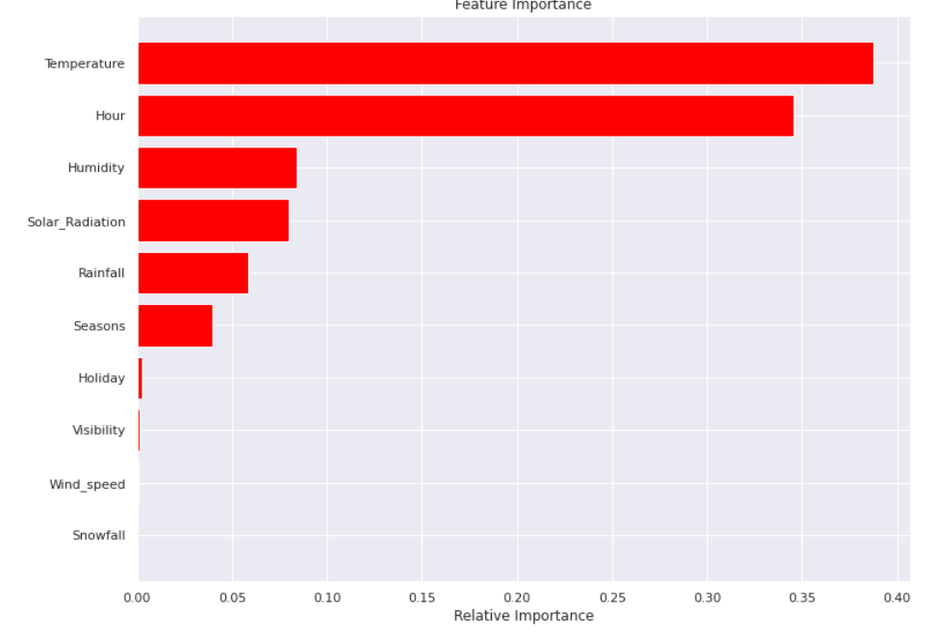
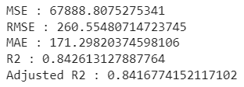
GRADIENT BOOSTING
Test Set Results

Slide 23
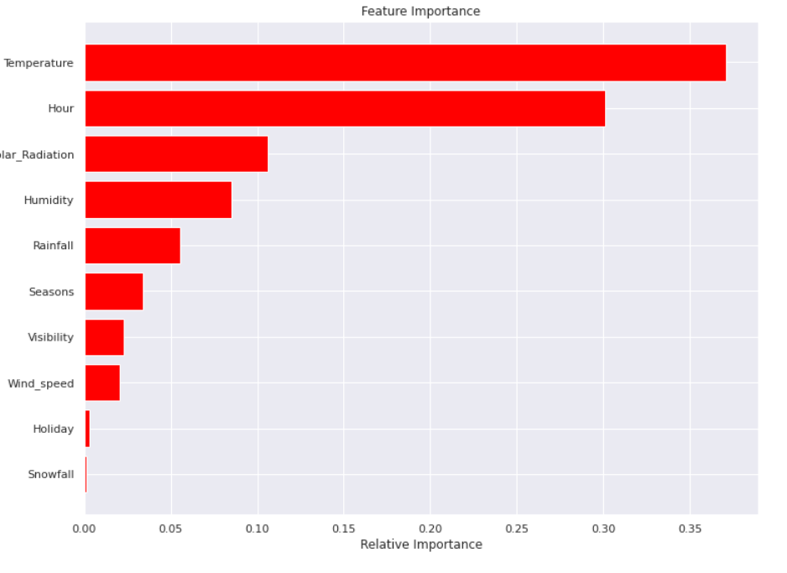
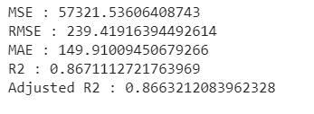
RANDOM FOREST
Test Set Results

Slide 24
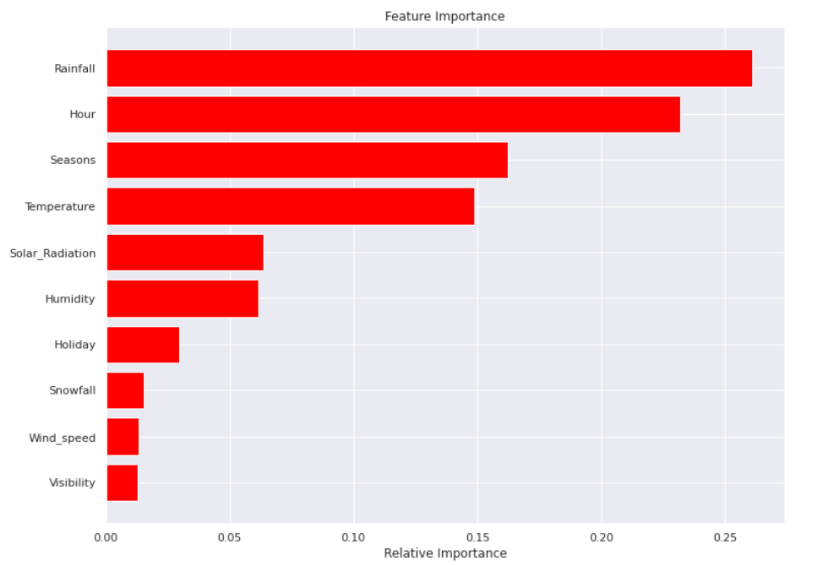
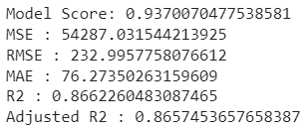
XGBOOST
Test Set Results

Slide 25
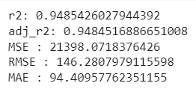
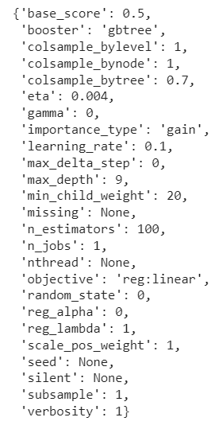
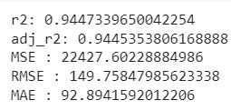
Grid Search CV on XGboost algorithm
Hyper parameter
Train Set Results
Test Set Results

Slide 26
CHALLENGES
Large Dataset to handle.
Needs to plot lot of Graphs to analyse.
Feature engineering
Feature selection
Optimising the model
Carefully tuned Hyperparameters as it affects the R2 score.

Slide 27
CONCLUSION
‘Hour’ of the day holds the most important feature.
Bike rental count is mostly correlated with the time of the day as it is peak at 10 am morning and 8 pm at evening.
We observed that bike rental count is high during working days than non working day.
We see that people generally prefer to bike at moderate to high temperatures, and when little windy
It is observed that highest number bike rentals counts in Autumn & Summer seasons & the lowest in winter season. We observed that the highest number of bike rentals on a clear day and the lowest on a snowy or rainy day. We observed that with increasing humidity, the number of bike rental counts decreases.

Slide 28
When we compare the root mean squared error and mean absolute error of all the models, Random forest Regressor and Gradient Boosting gridsearchcv gives the highest R2 score of 99% and 95% respectively for Train Set and 92% for Test set. So, ﬁnally this model is best for predicting the bike rental count on daily basis.

Slide 29
THANK YOU

